Slide 1

Analytical Insights in Sales and Financial Performance: A Case Study on AtliQ Hardware
-Srabana Baidya

Slide 2
Contents :
Introduction
Methodology
Reports
Insights & Key Findings
Achievements

Slide 3
Introduction :
In this project, we comprehensively explore Sales and Finance analytics, dissecting customer net sales and navigating the financial landscape through profit and loss reports.
The major objectives of this project are:
1. Data-Driven Decision-Making: We took a hands-on approach, leveraging advanced Excel, Power Query, and Power Pivot to ensure our decisions were rooted in solid data.
2. Integrated Insights: In our analysis, we integrated insights from both sales and finance. We've calculated and cross-referenced the numbers, ensuring a comprehensive understanding.
3. Key Findings Unveiled: We delved into the world of data-driven decision-making, unearthing key findings that have been carefully calculated. These findings illuminate our path to global recognition, operational efficiency, and surpassing market targets.
4. Strategic Blueprint Developed: This isn't just an analysis; it's a strategic blueprint we've developed using a combination of analytical tools and problem-solving skills. We've calculated our steps for sustained excellence across every facet of our business operations.

Slide 4
Methodology :
Tools Utilized
Power Pivot: Leveraged for enhanced data modeling and analysis capabilities.
Power Query: Applied for efficient data extraction, transformation, and loading (ETL) processes.
Data Modeling: Utilized for structuring and organizing data to derive meaningful insights.
Conditional Formatting: Employed to enhance visual representation and highlight key metrics.
Pivot Table: Utilized for dynamic and interactive data summarization.

Slide 5
Sales Analytics Report

Slide 6
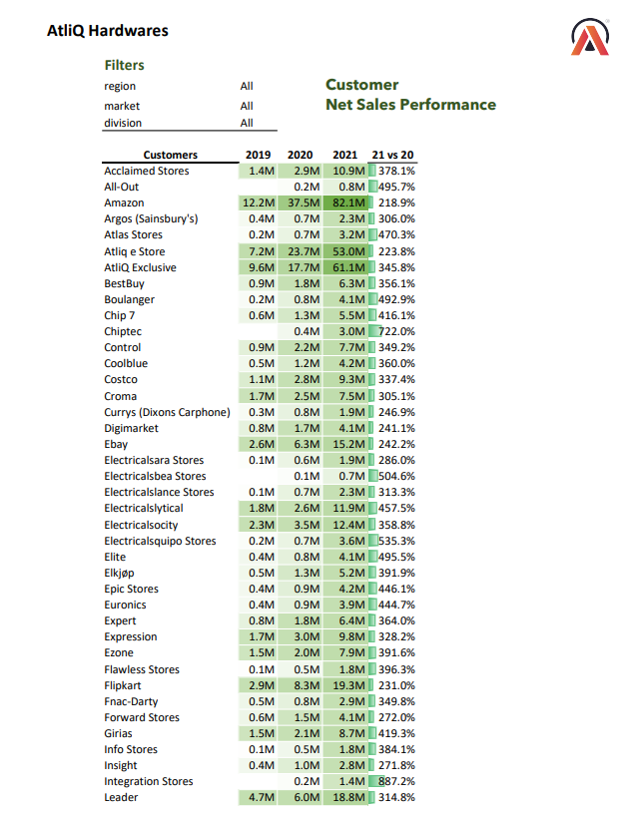

Slide 7
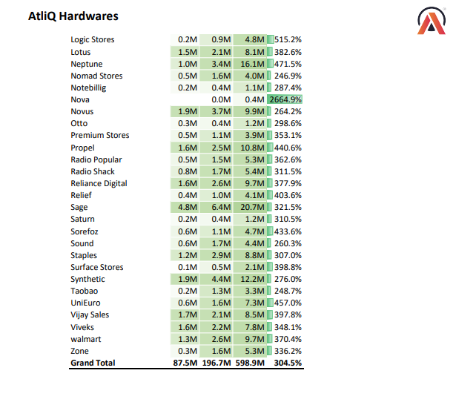

Slide 8
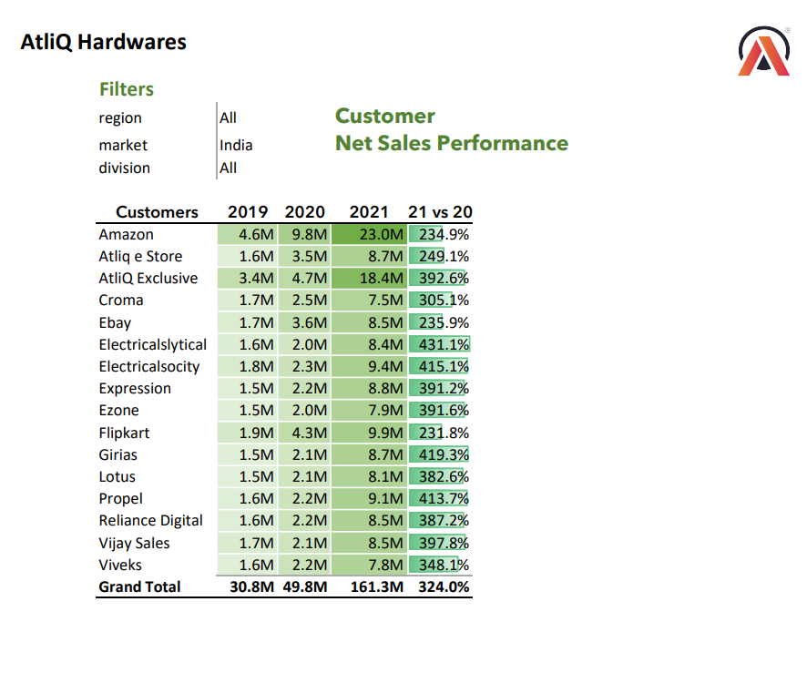

Slide 9
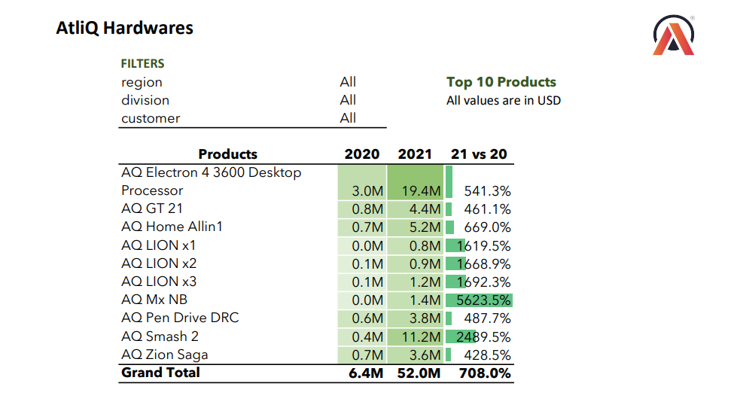

Slide 10
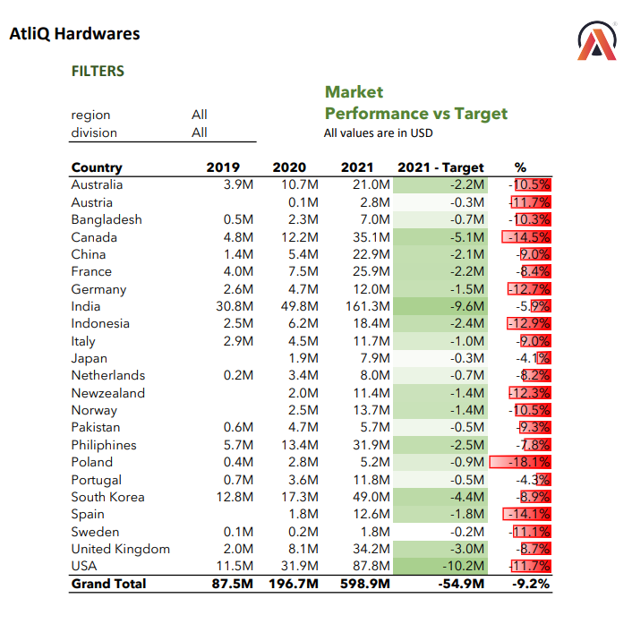

Slide 11
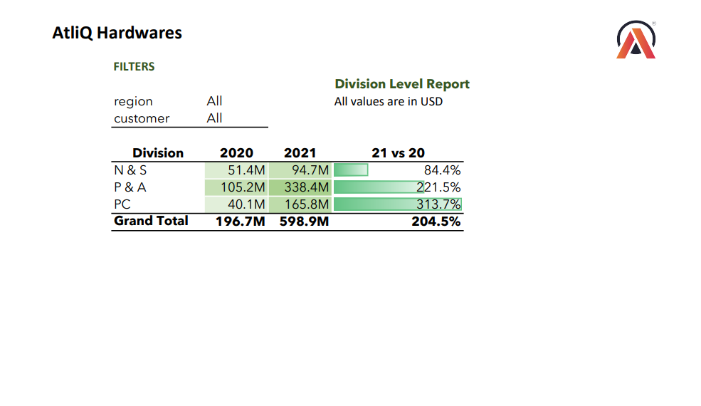

Slide 12
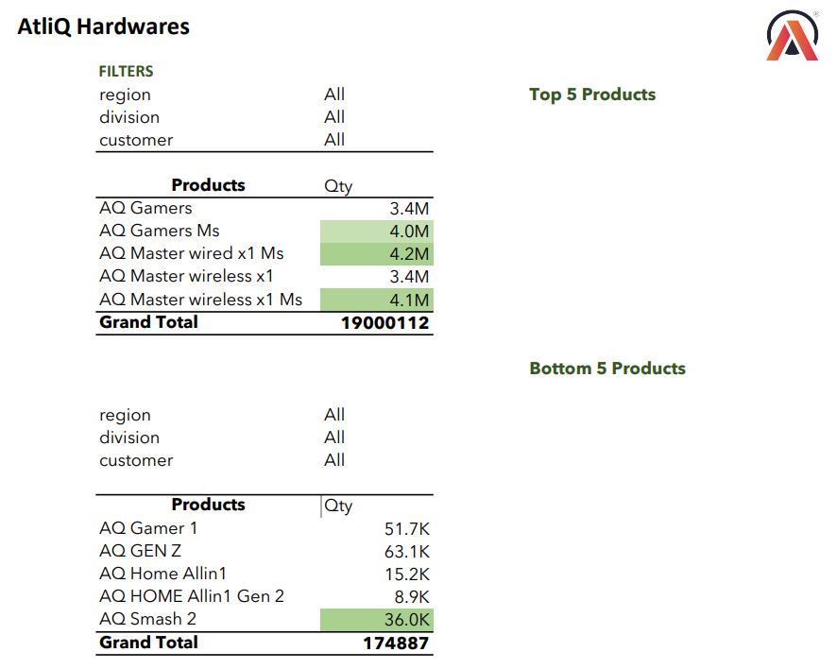

Slide 13
FINANCE Analytics Report

Slide 14
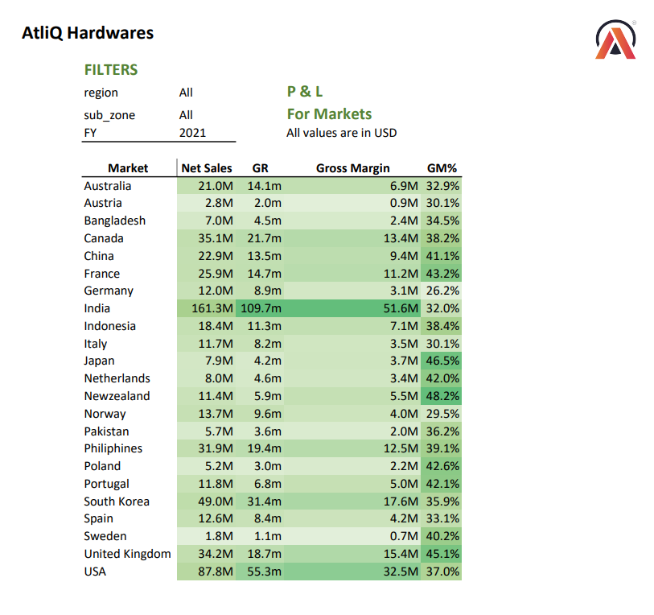

Slide 15
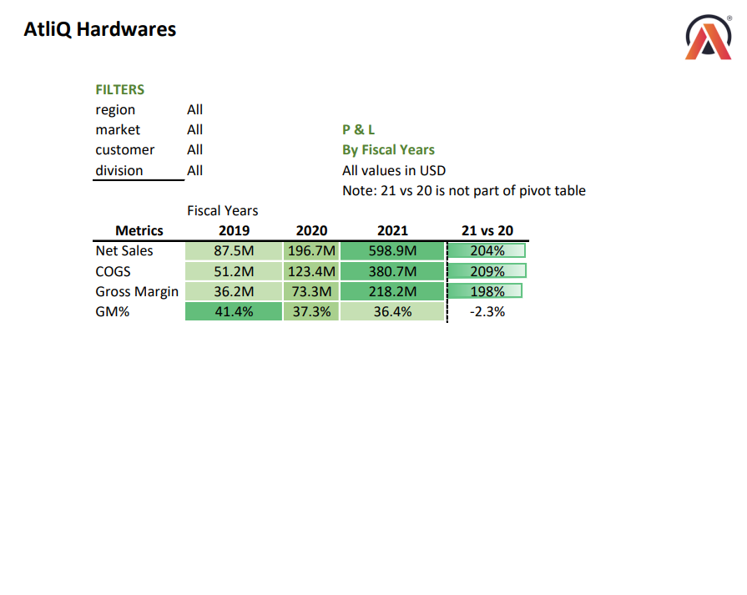

Slide 16
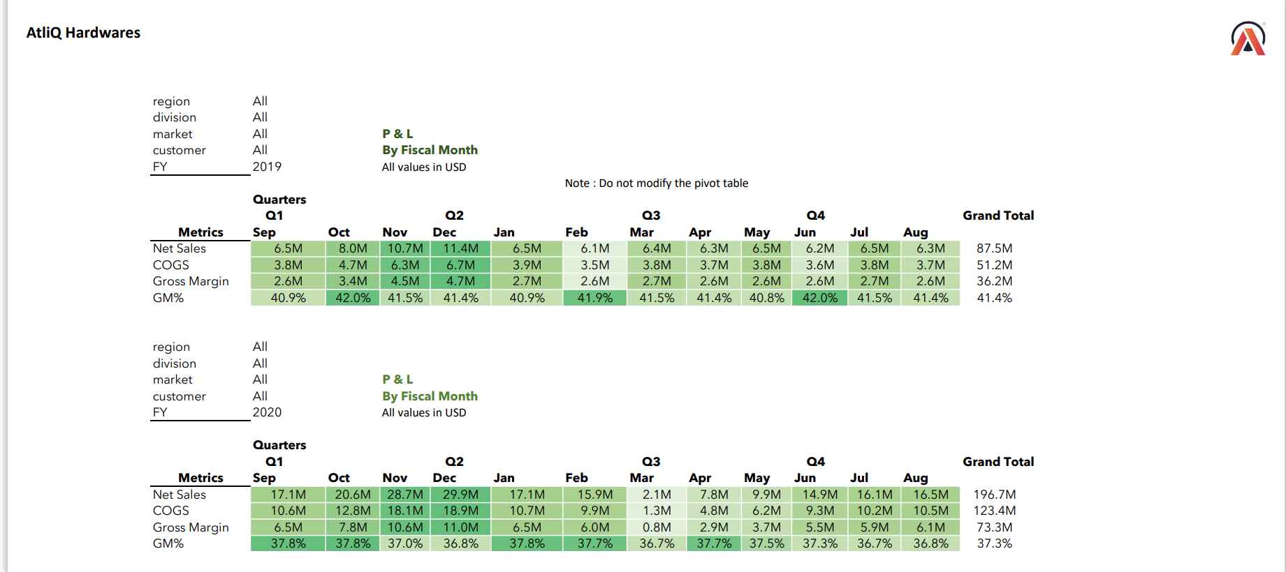

Slide 17
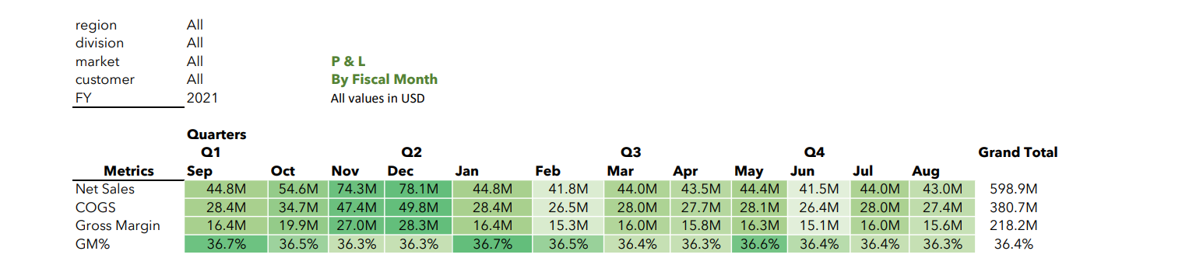
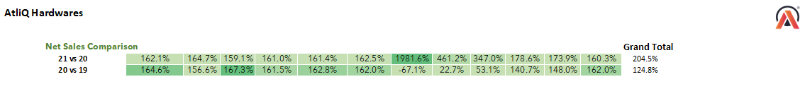

Slide 18
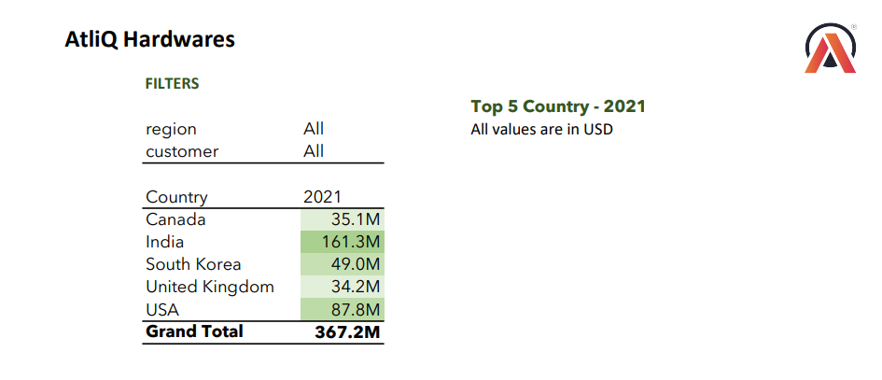

Slide 19
INSIGHTS & Key findings :
Sales Analytics Insights:
Customer Net Sales Performance: Revealed a robust overall growth, reflecting the effectiveness of our sales strategies.
Market Performance in India: Highlighted a thriving market presence, indicating opportunities for further expansion.
Top 10 Products Report: Strategic insights into product performance, guiding future development and marketing endeavors.
Market Performance vs. Target: Provided a comprehensive overview, allowing for agile adjustments to meet and exceed market targets.
Finance Analytics Insights:
Profit and Loss by Market: Illuminated financial health across markets, aiding in strategic financial planning.
Profit and Loss by Fiscal Year: Provided a detailed fiscal perspective, contributing to long-term financial stability.
Profit and Loss by Fiscal Quarter/Month: Granular insights into financial performance over time, facilitating agile decision-making.
Top 5 Countries in 2021: Recognized our financial prowess on a global scale, solidifying our position in the market.

Slide 20
Achievements :
Boosted Accuracy in Analysis: We used Power Pivot, Power Query, and Pivot Tables to carefully look at sales and financial data, making sure we got things exactly right.
Found Paths for Growth: By playing with Data Modeling, we figured out where we could grow. This helped us plan for the future and decide how to sell our stuff, especially in India.
Quick Moves with Agile Decisions: We used Conditional Formatting to get a fast look at how well the market was doing. This made it easy to change things up quickly and beat our goals.
Financial Health in the Spotlight: We looked at Profit and Loss reports to see how we were doing financially. This helped us plan for the future and stay stable in the long run.
Got Noticed Worldwide: People around the world recognized us for being really good with money, which helped us stay strong in the market, especially in the top 5 countries in 2021.
Made Things Run Smooth: We used Data Modeling and Power Query to make everything run better. It gave us detailed looks at how we were doing financially and helped us make smart decisions..

Slide 21


Thank You

